Slide 1

Exploring University of Chicago Hiring Practices
MACS 30122 | Max Headroom | Winter 2022
Kaya Borlase | Lynette Dang | Isabella Duan | Joseph Helbing

Slide 2
Project Description and Goals
“The faculty members of UChicago College are distinguished scholars and scientists renowned for shaping and defining entire fields of study. The faculty members are also infused with a strong sense of pride in their teaching and a profound commitment that their work as educators will have a dramatic impact in defending the fundamental values and the style of intellectual life that defines the University” (UChicago, 2022)
How do you screen for this?
What does UChicago consider “distinguished”?
Notes:
description of the topic (in one sentence or so communicate to the audience what your project is about)

Slide 3
Data Overview
NOTE: We limit “faculty” to faculty members who have their doctorate degree
Scraped data from uchicago.edu
Two Departments:
Social Sciences Division
Harris School of Public Policy
Sample Size:
150-200 faculty per department
Limits:
Difficult to scrape
Worldwide University Rankings
From 2012
Limits:
Dated
Advantages:
Complete
Notes:
data: data sources (brief overview), total sample size, limits, and advantages of your collected data

Slide 4
Data Collection and Cleaning
Social Science Division Data/Harris School of Public Policy
General Process:
Web crawler to pull faculty links
Visit each link and brute force find_all <p>
Pull out <p> with “doctorate” values
Challenges:
Differences:
Between pages
Between divisions
Missing Data:
Could we ethically gather data not on site publicly?
Manual checks
Luckily, missing data matched our distribution, from what we could tell
→ In both cases, fine-tuning regex is really what made the biggest difference
Notes:
data collection: more in -depth description of the data sources, share some details about your scraping experience (challenges, solutions, etc.) so the whole class can benefit from your knowledge

Slide 5
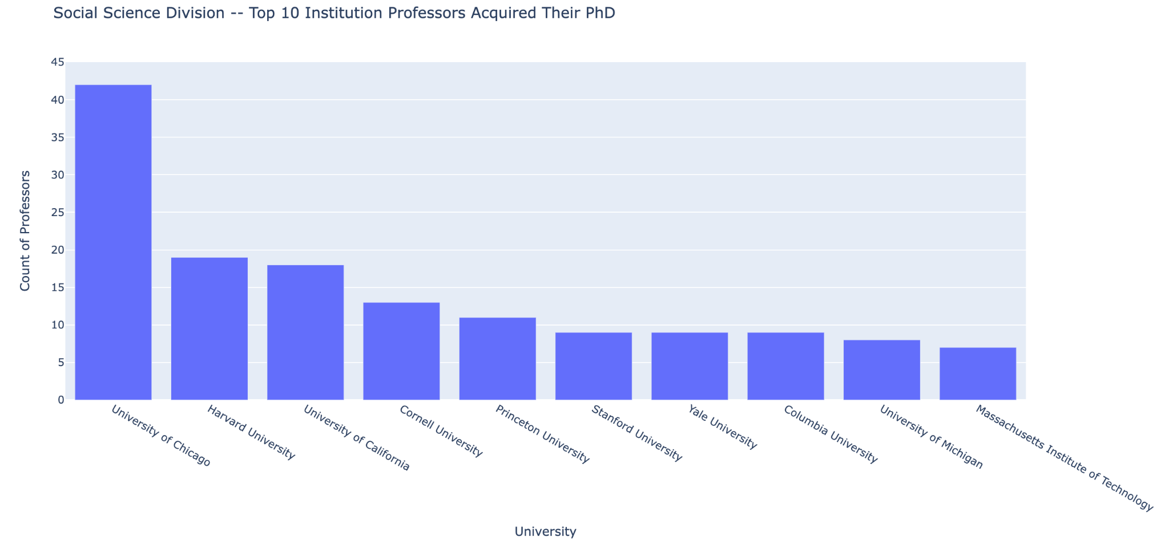
Basic Data Analysis/Visualization
Temp Text
Notes:
data analysis/visualization: present your analysis or final product (if you are modeling data, present the model and approach as well)

Slide 6
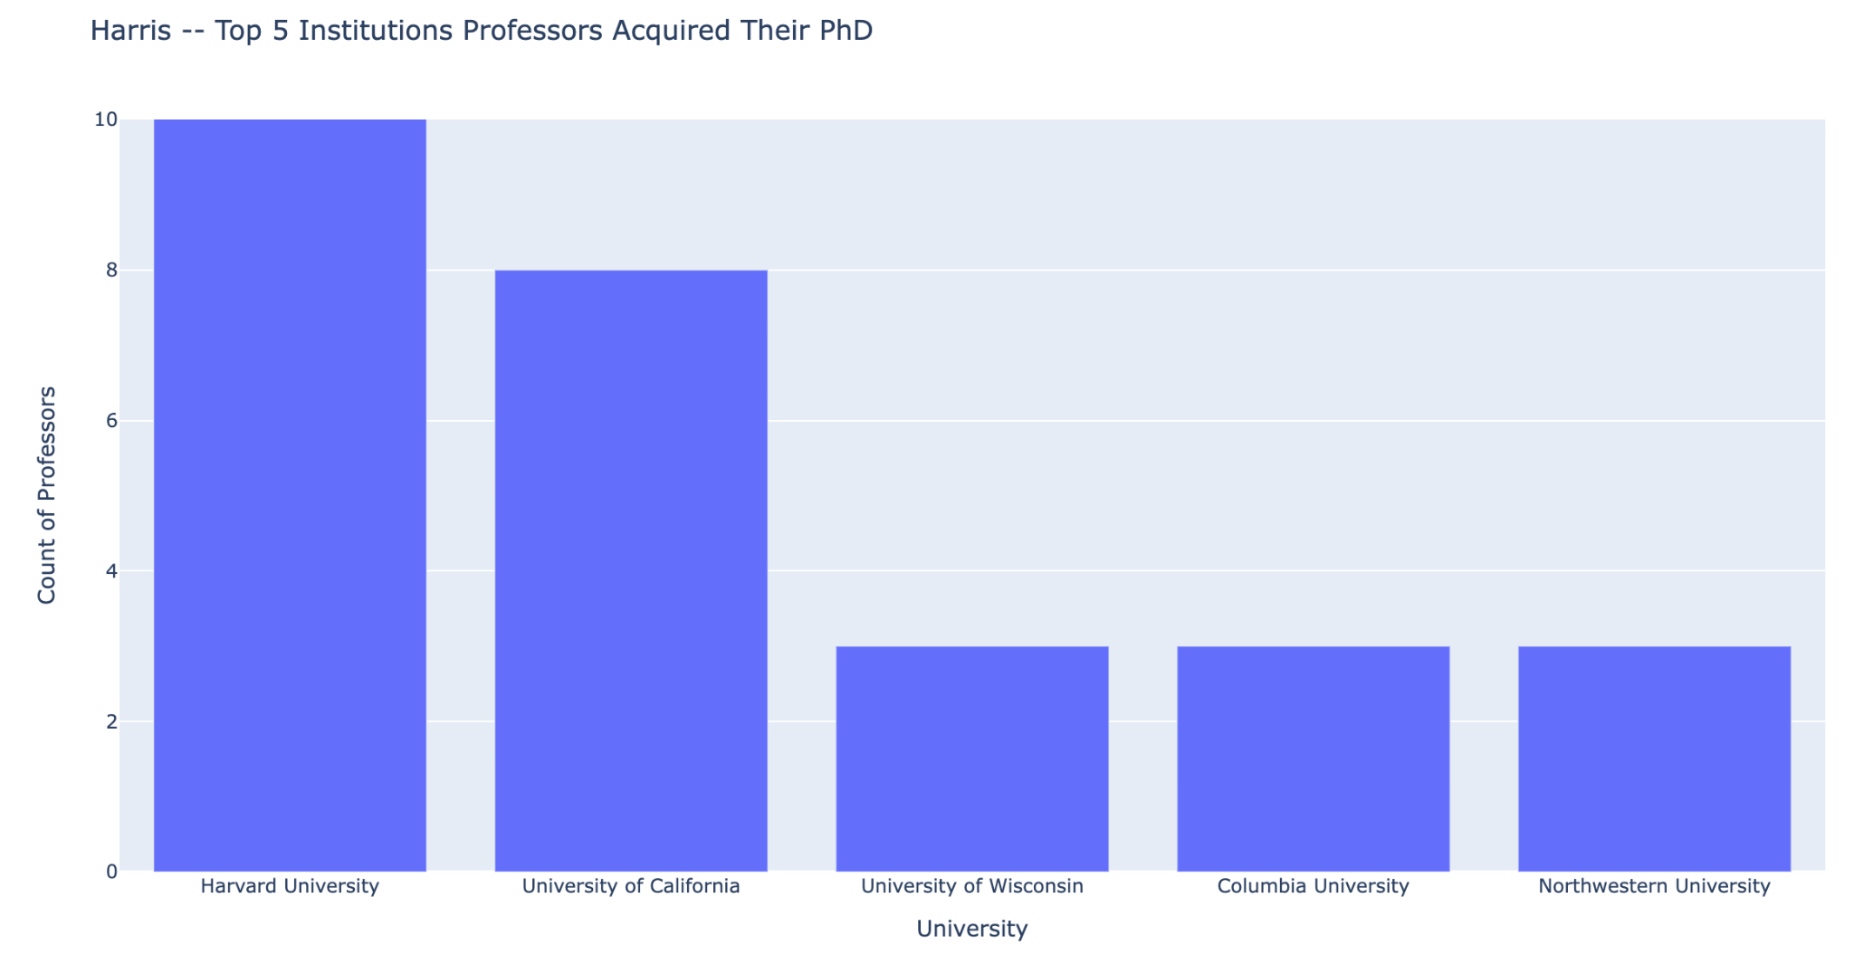
Notes:
data analysis/visualization: present your analysis or final product (if you are modeling data, present the model and approach as well)

Slide 7

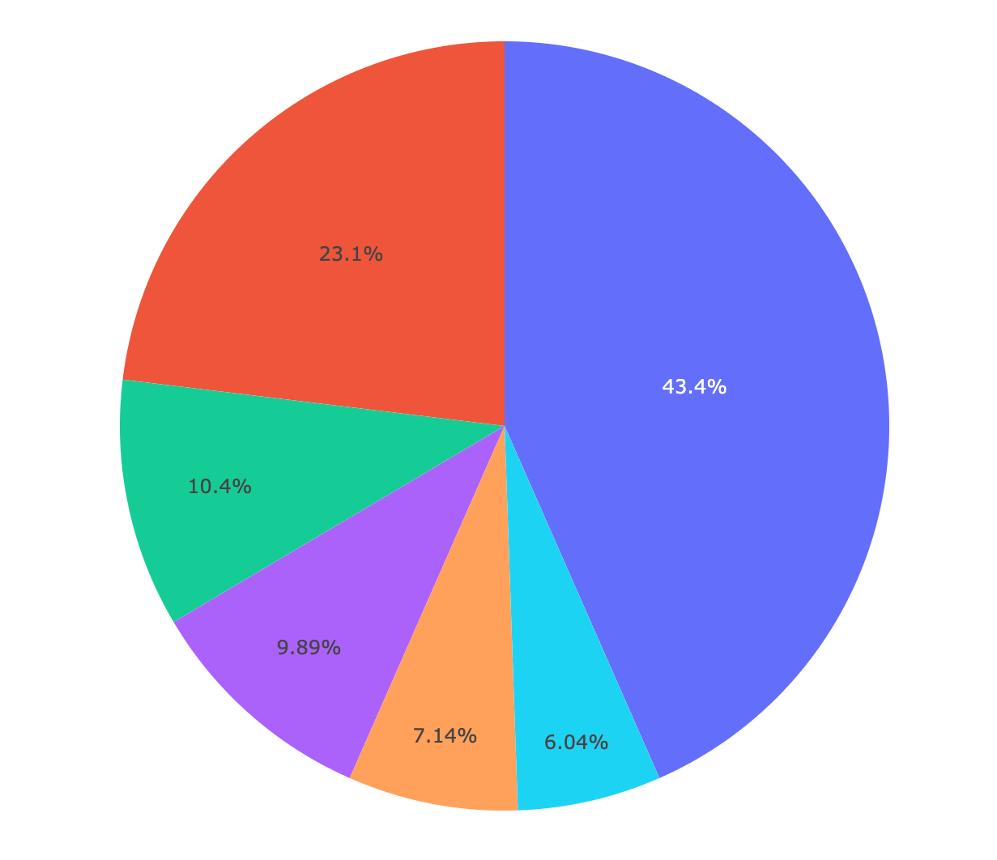
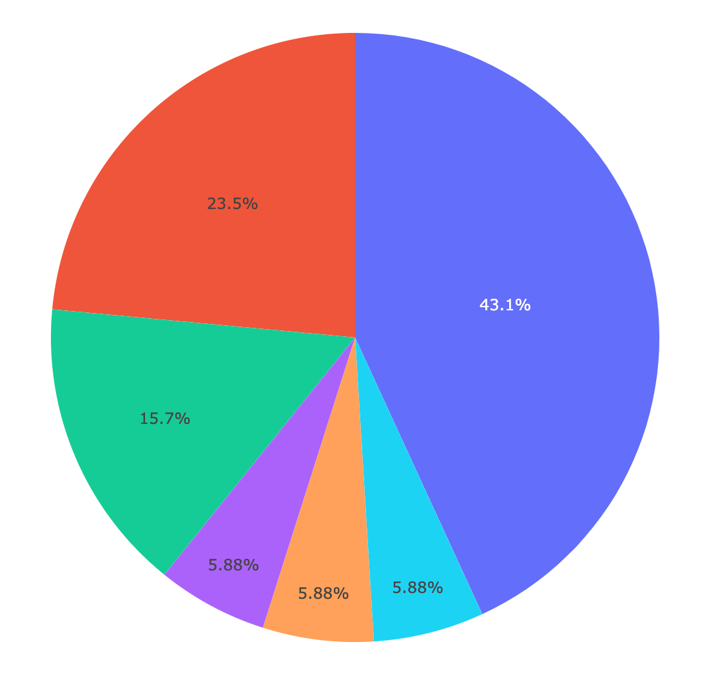
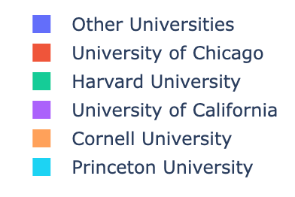
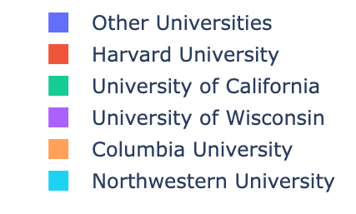
SSD
Harris
Notes:
data cleaning: no need to go in details here, but perhaps share some take-home-points or tricks that you learned, if you think they might be helpful for the class

Slide 8
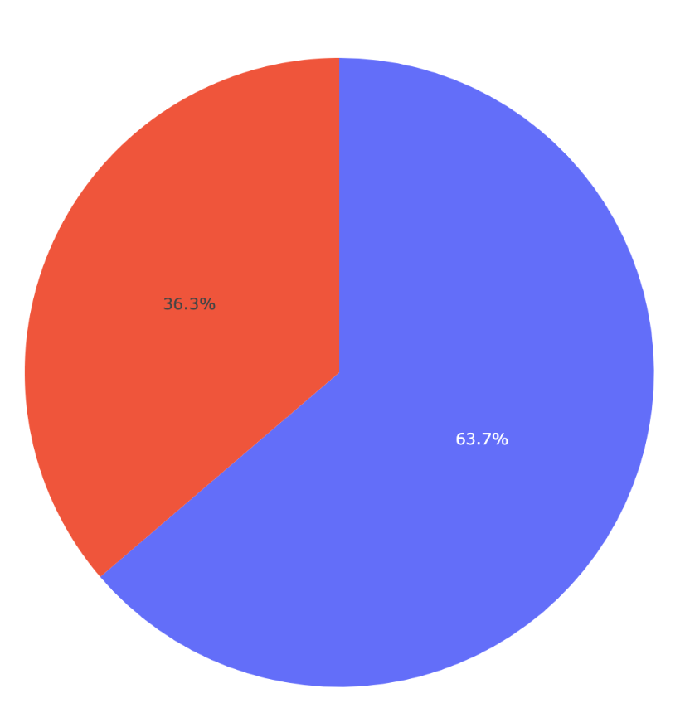
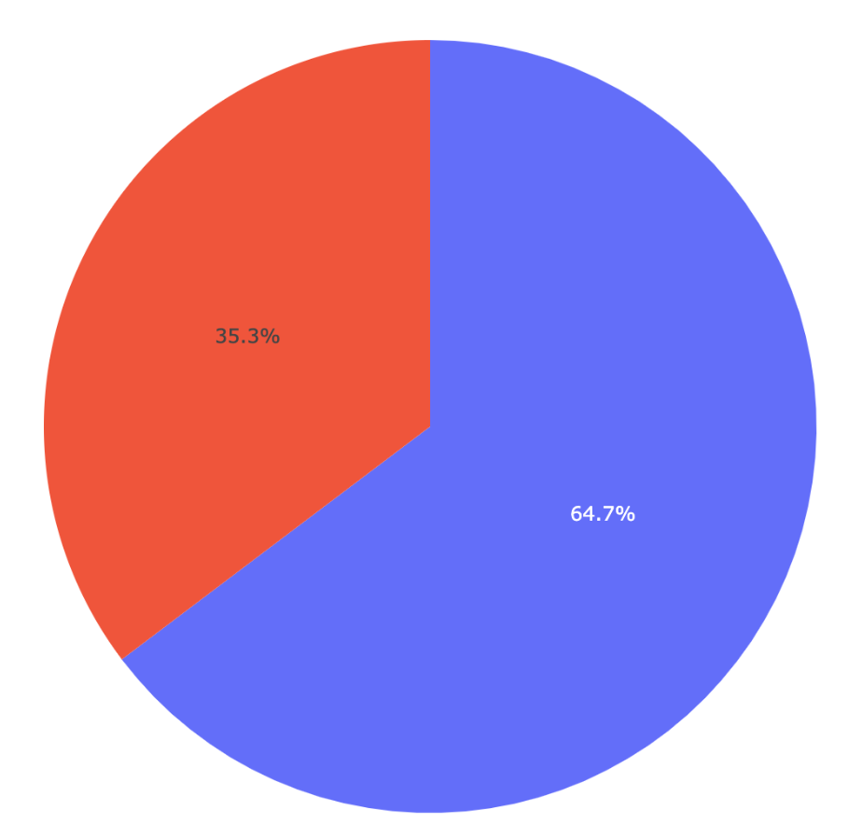
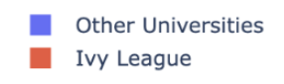
SSD
Harris

Slide 9

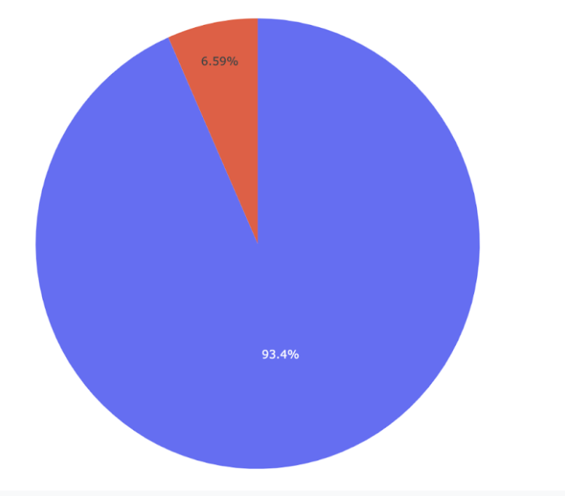
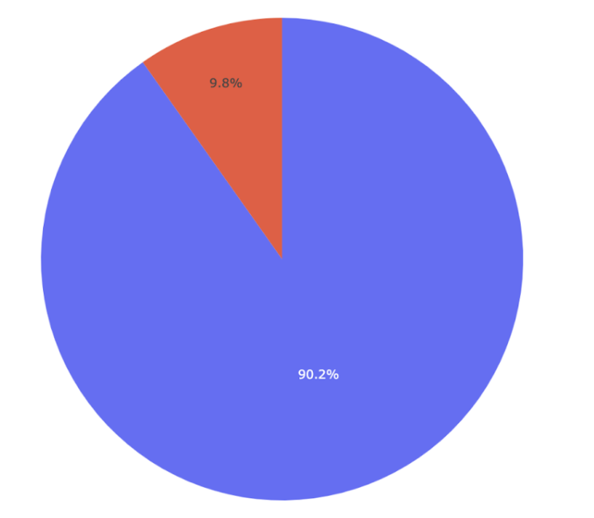
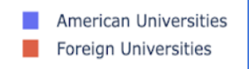
SSD
Harris

Slide 10
Harris VS SSD
Differences:
Harris hires many that don’t have a PhD degree
Harris is more “international” when it comes to hiring
Similarity:
Both divisions love hiring PhDs from Uchicago and Ivy league
Ivy league dominates ~35% of faculty pool
Both divisions hire predominantly faculty who completed their PhD from the US, with some level of exceptions
Notes:
Public policy is a more "applied" field compared to social science → many faculty doesn’t have PhD but has a lot of industry experience
Public policy school might want to hire faculty who have experience practicing policy solutions around the world

Slide 11
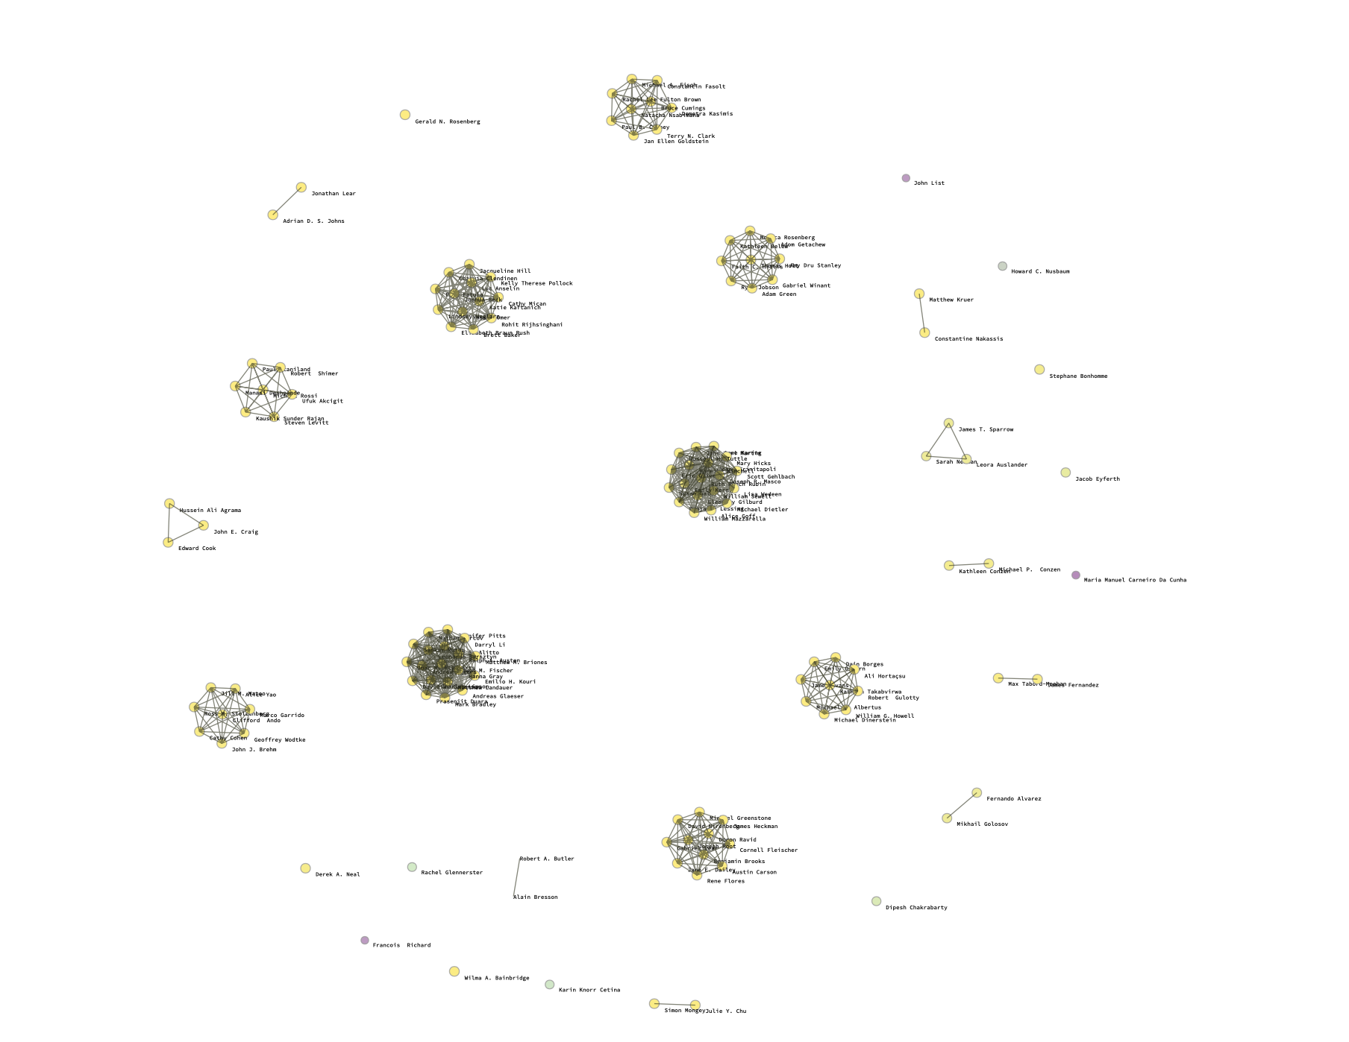
SSD - Networks of Faculty graduating from the same university
Notes:
Each faculty is a node, each link represents the two faculty come from the same university

Slide 12
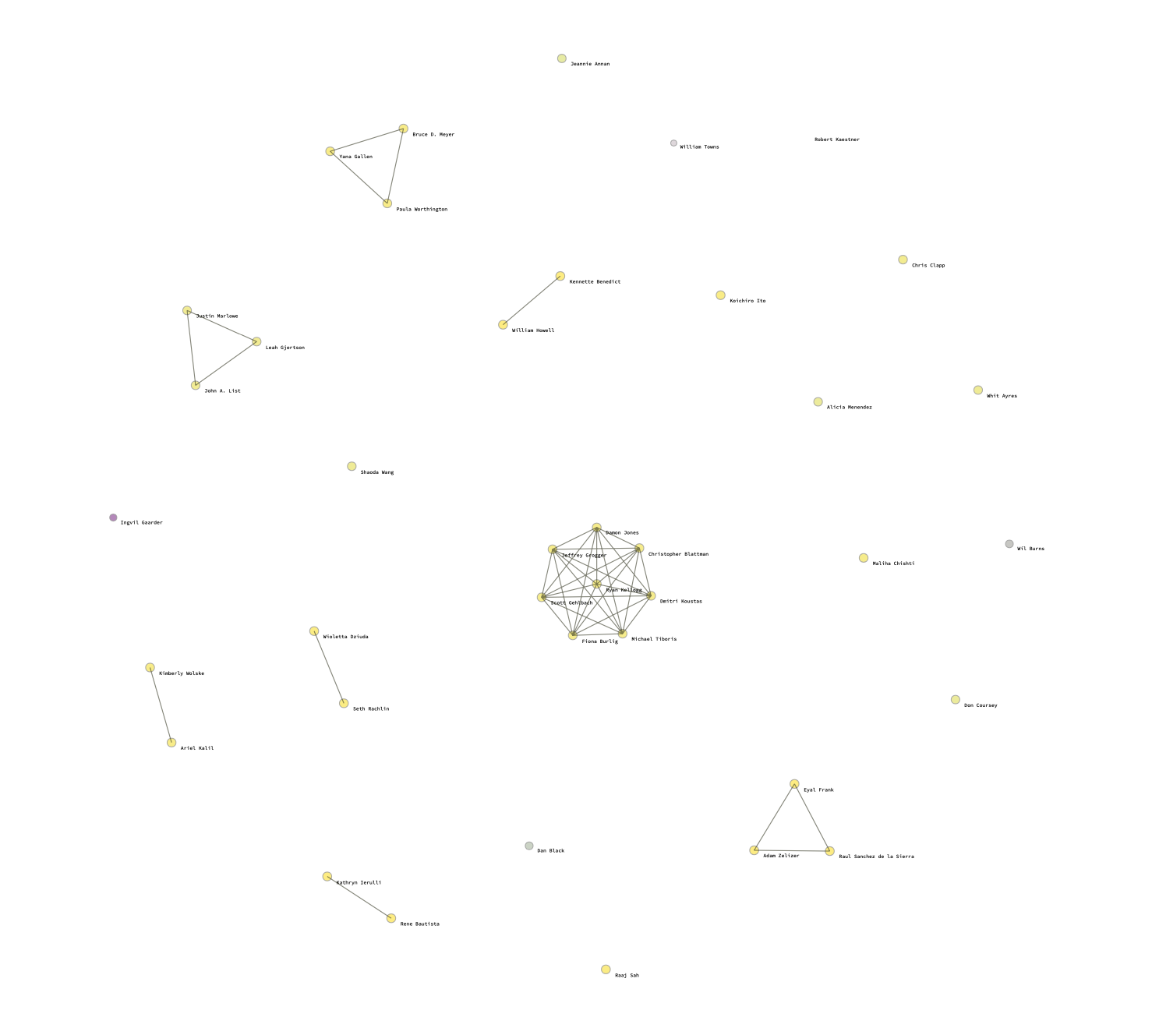
Harris - Networks of Faculty graduating from the same university
Notes:
More inclusive, democratic

Slide 13
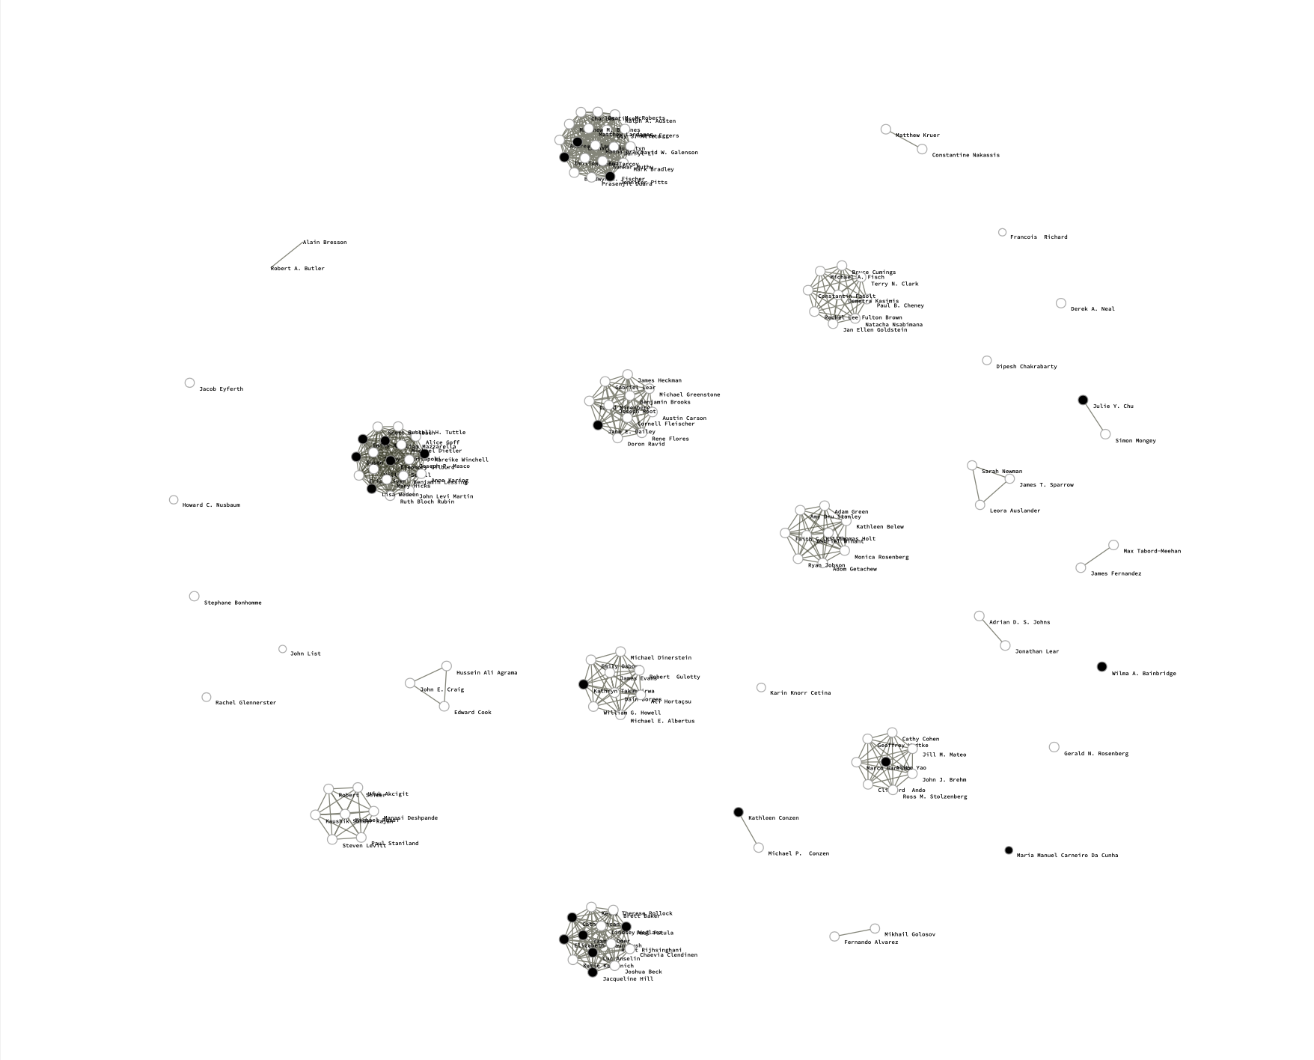
SSD Networks with Gender
White nodes: Men
Black nodes: Women
Notes:
Use nlp pipeline to predict race & gender from name; most female faculty come from big clusters, high-ranked uni -> higher barriers

Slide 14
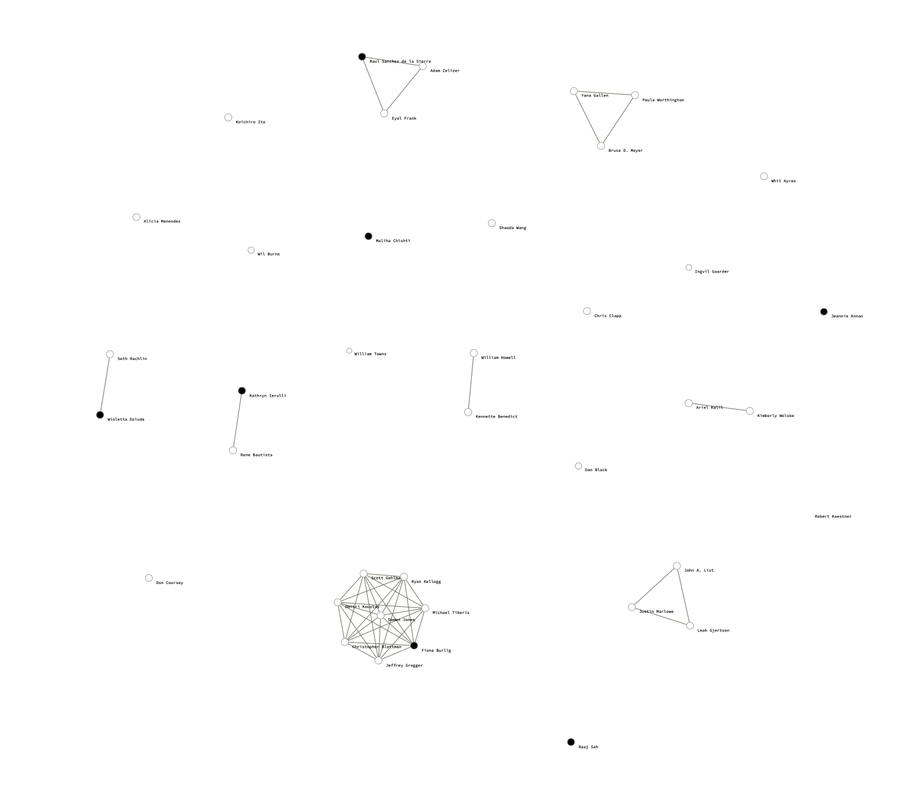
Harris Networks with Gender
White nodes: Men
Black nodes: Women
Notes:
Lower barriers for female faculty

Slide 15
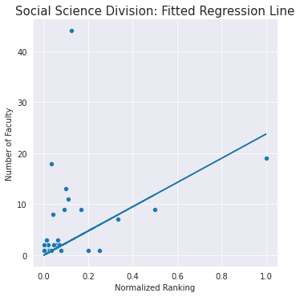
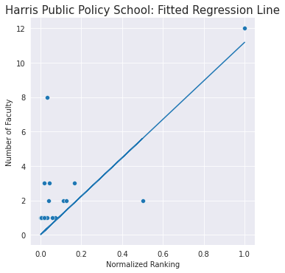
Notes:
We also fit linear regression. We take the inverse of university ranking and scale it using a function in sklearn to create a normalized ranking variable, high score ~ top ranks. We use it as independent variable and model how it affects the number of hire UChicago hire from that university

Slide 16
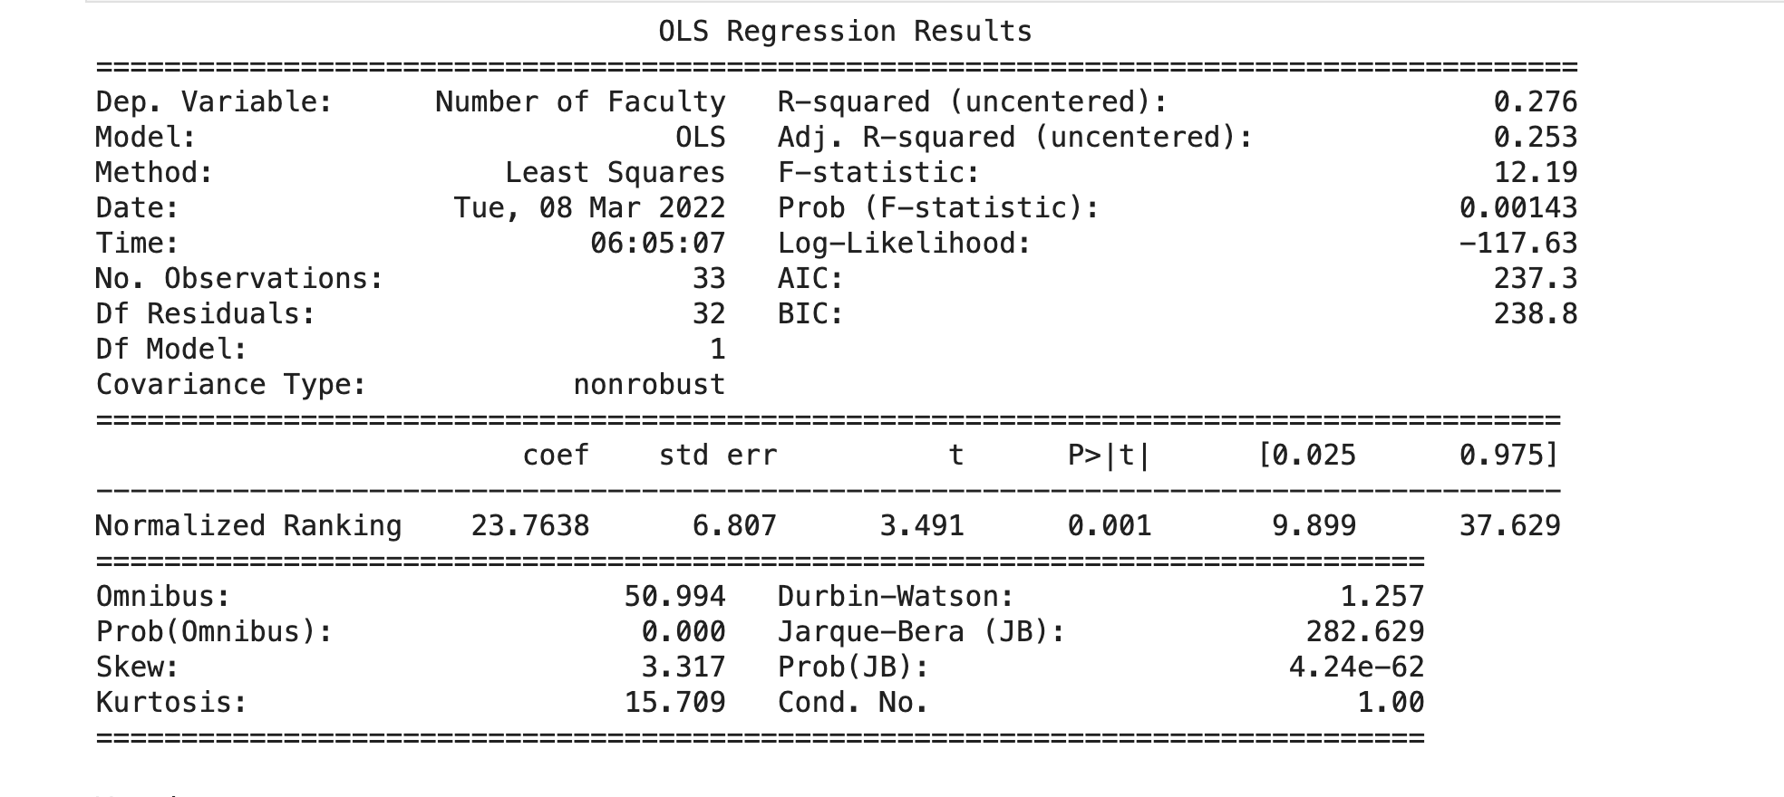
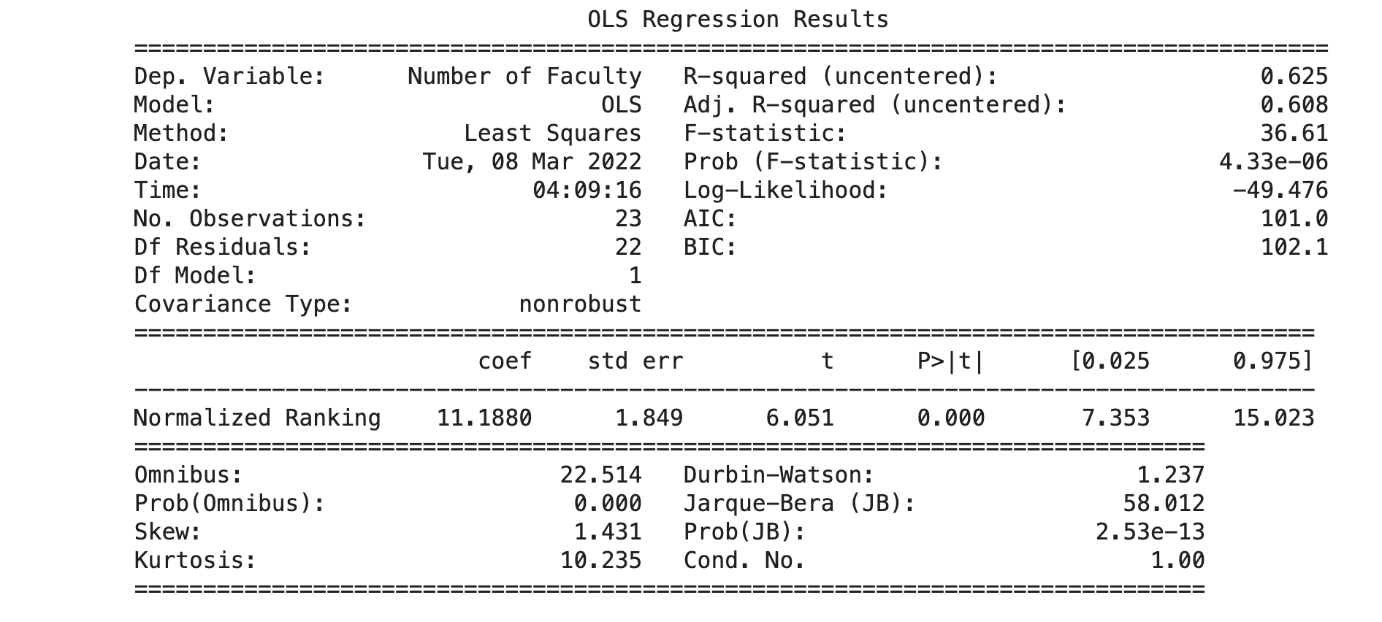
SSD
Harris

Slide 17
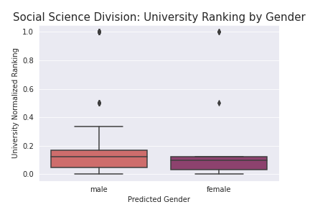
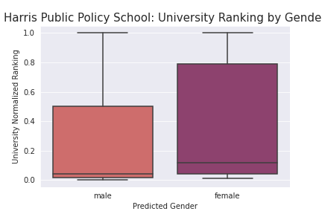
Notes:
With this normalized ranking variable, we also plot the box plot of how this scores distributes across faculty from different gender & ethnic groups. More clearly show that harris hire from lower rank university, less gender barriers

Slide 18
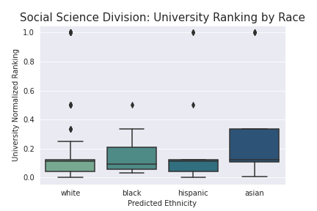
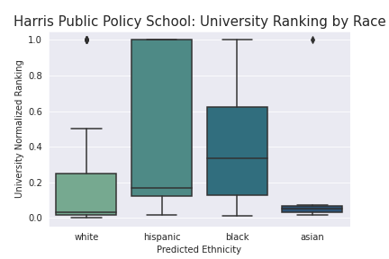
Notes:
Less race barriers for hispanic and black ethnic groups

Slide 19
Future Developments
Increase scope of data
More departments
More schools
More degree levels
Handling of missing/incomplete data
Could we have manually gathered
Through CVs
Other personal websites?
Geospatial Analysis
Beyond school ranking, does school location impact hiring practices? (national/regional) → interactive heatmap
Notes:
future developments: work that could be done to improve your project

Slide 20
Take-home Points
It’s difficult to
Build a scraper that works for every website to get faculty information
Extract faculty educational information through regex
Notes:
take-home point: what you learned the most while working on this project, suggestions, etc.

Slide 21
Also,
If you would like to teach at UChicago you should:
Preferably be an alum or an ivy-league grad
Get your PhD from top 10-20 Schools
Choose an American PhD program
And if you want to join SSD, it helps to be a white male

